Slide 1

Creating Java Objects
Creating our own java objects
pick the object
decide on the attributes to represent
Create your .java file
Declare your instance variables – one for each attribute
Write your getter and setter methods – one for each attribute
Now we need a way to construct our objects!

Slide 2
Specifying Constructors
Initialize objects
Set the initial data for objects when they are constructed
Example
Car car1 = new Car(1967, “blue”, “Camaro”);
Similar to a method with two differences:
The name is always the same as the name of the class
Constructors have no return type

Slide 3
Specifying Constructors: Car
//ASSUMES INSTANCE VARIABLES: year, color and model
public Car (int inputYear, String inputColor, String inputModel){
year = inputYear;
color = inputColor;
model = inputModel;
}
Now constructor call from previous slide makes nice sense:
Car car1 = new Car(1967, “blue”, “Camaro”);

Slide 4
BankAccount Public Interface
The constructors and methods of a class go inside the class declaration:
public class BankAccount
{
private double balance; //instance variables
// Constructors
public BankAccount(double inputBalance)
{
balance = inputBalance;
}
Continued

Slide 5
BankAccount Public Interface
// Methods
public void setBalance(double inputBalance)
{
balance = inputBalance;
}
public double getBalance()
{
return balance;
}
public static void main(String[] args){
}
}

Slide 6
Specifying the Public Interface of a Class
public constructors and methods of a class form the public interface of the class.
These are the operations that any programmer can use.

Slide 7
Creating the Public Interface of a Class
In order to implement a class, you need to know which methods are required.
Essential behavior of a bank account:
deposit money
withdraw money
get balance

Slide 8
Creating the Public Interface of a Class
We want to support method calls such as the following:
harrysChecking.deposit(2000);
harrysChecking.withdraw(500);
System.out.println(“Balance: “ + harrysChecking.getBalance());
Here are the method headers needed for a BankAccount class:
public void deposit(double amount)
public void withdraw(double amount)

Slide 9
Specifying the Public Interface of a Class: Method Declaration
A method's body consisting of statements that are executed when the method is called:
public void deposit(double amount)
{
balance = balance + amount.
}
You can fill in the method body so it compiles:
public void withdraw(double amount)
{
balance = balance - amount;
}

Slide 10
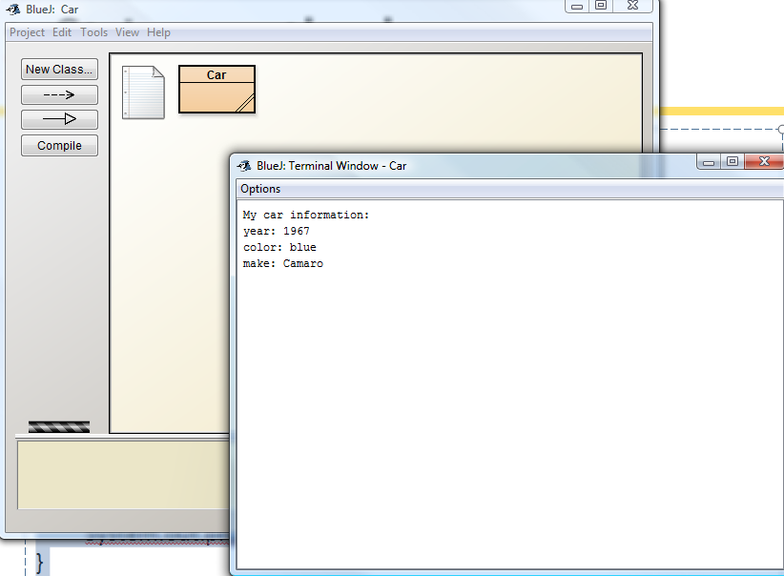
toString method
public String toString(){
String outputString = new String();
outputString = “My car information: \n“;
outputString = outputString + “year: “ + year + "\n";
outputString = outputString + “color: “ + color + "\n";
outputString = outputString + “make: “ + make + "\n";
return outputString;
}
public static void main(String args[]){
Car myCar = new Car(1967, “blue”, “Camaro”);
System.out.println(myCar.toString());
}

Slide 11
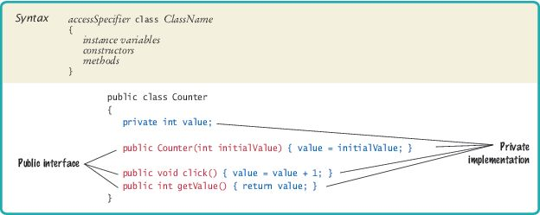
Syntax 3.2 Class Declaration

Slide 12
Commenting the Public Interface – Documenting a Method
Start the comment with a /**.
Describe the method’s purpose.
Describe each parameter:
start with @param
name of the parameter that holds the argument
a short explanation of the argument
Describe the return value:
start with @return
describe the return value
Omit @param tag for methods that have no arguments.
Omit the @return tag for methods whose return type is void.
End with */.

Slide 13
Commenting the Public Interface – Documenting a Method
Example:
/** Withdraws money from the bank account.
@param amount the amount to withdraw
*/
public void withdraw(double amount)
{
implementation—filled in later
}

Slide 14
Commenting the Public Interface – Documenting a Method
Example:
/** Gets the current balance of the bank account.
@return the current balance
*/
public double getBalance()
{
implementation—filled in later
}

Slide 15
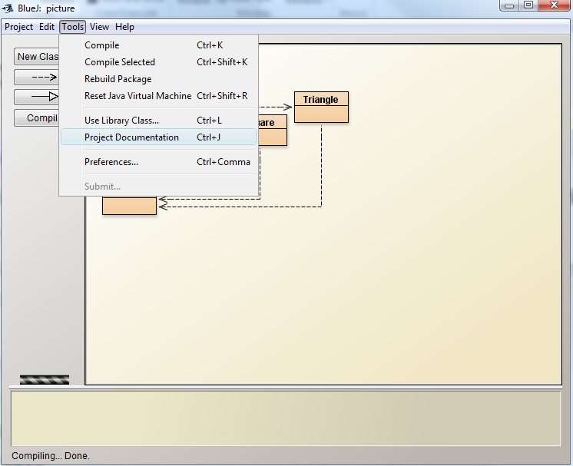
JavaDoc in BlueJ

Slide 16
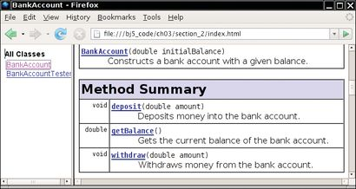
Method Summary
Figure 3 A Method Summary Generated by javadoc

Slide 17
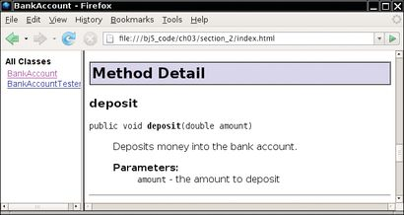
Method Details
Figure 4 Method Detail Generated by javadoc

Slide 18
Self Check 3.6
How can you use the methods of the public interface to empty the harrysChecking bank account?
Answer:
harrysChecking.withdraw(harrysChecking.getBalance());

Slide 19
Self Check 3.7
What is wrong with this sequence of statements?
BankAccount harrysChecking = new BankAccount(10000);
System.out.println(harrysChecking.withdraw(500));
Answer: The withdraw method has return type void. It doesn’t return a value. You can’t embed that in a println – there is nothing to print.
Use the getBalance method to obtain the balance after the withdrawal.

Slide 20
Self Check 3.8
Suppose you want a more powerful bank account abstraction that keeps track of an account number in addition to the balance. How would you change your code?
Answer:
Add an instance variable accountNumber
Set accountNumber in the constructor, and add a getAccountNumber method and a setAccountNumber method.

